Slide 1
Coalescent models
Consider a genealogy (gene tree) for a sample of homologous gene copies
If you knew the total length of the tree - the total time spanned by all the branches
We can call this T_{tot}
then the number of neutral mutations on that tree will be uT_{tot} .
But how do we get the length of the tree ??

Slide 2
Simulating Gene Ancestry in a small population
Past
Generation #
8
7
6
5
4
3
2
1
0
Present

Slide 3
Simulating Gene Ancestry in a small population
Past
Generation #
8
7
6
5
4
3
2
1
0
Present

Slide 4
Simulating Gene Ancestry in a small population
Past
Generation #
8
7
6
5
4
3
2
1
0
Present

Slide 5
Simulating Gene Ancestry in a small population
Past
Generation #
8
7
6
5
4
3
2
1
0
Present

Slide 6
Simulating Gene Ancestry in a small population
Past
Generation #
8
7
6
5
4
3
2
1
0
Present

Slide 7
Simulating Gene Ancestry in a small population
Past
Generation #
8
7
6
5
t2=6
4
3
2
1
t3=2
0
Present

Slide 8
Question
Past
2 questions:
What is the time back to the most recent common ancestor of all the sequences?
What is the total length of the tree Ttot ?
t2
t3
Present time

Slide 9
Past
What is the time back to the most recent common ancestor of all the sequences?
t3 + t2
What is the total length of the tree Ttot ?
Ttot = 3×t3 + 2×t2
t2
t3
Present time
Sample 3 gene copies

Slide 10
Adding Mutation - Example 1 – no mutation
Sequence of Most Recent Common Ancestral Gene Copy
Past
GCTTA
Sampled Sequences
GCTTA
GCTTA
GCTTA
Present time

Slide 11




Example 2 – One mutation
Sequence of Most Recent Common Ancestral Gene Copy
Past
GCTTA
Mutations in the ancestral gene tree of a sample of sequences show up as differences in the sampled sequences
GCTTA → GCTCA
Sampled Sequences
GCTTA
GCTTA
GCTCA
Present time

Slide 12

Example 3 – One mutation
Sequence of Most Recent Common Ancestral Gene Copy
Past
GCTTA
GCTTA → GCTCA
Sampled Sequences
GCTCA
GCTCA
GCTTA
Present time

Slide 13
Example 4 – Two mutations
Sequence of Most Recent Common Ancestral Gene Copy
Past
GCTTA
GCTTA → GCTCA
Sampled Sequences
GCTTA → ACTTA
GCTTA
ACTTA
GCTCA
Present time

Slide 14
Coalescent theory
A body of mathematical models of the probabilities of the genealogies of samples of gene/genome samples

Slide 15
Simple Coalescent models
Assumptions
constant population size (N does not change)
every gene copy equally likely to be passed on
This is the same as having no natural selection in the model
These are stochastic neutral models

Slide 16
When did two gene copies have a common ancestor?
Pick two gene copies at random from a diploid population with N individuals.
What is the probability they had a common ancestor the previous generation?
1/(2N)
What is the probability they did not have a common ancestor in the last generation?
1-1/(2N).
Let t be the time, in generations, of the common ancestor of these two sequences, where t goes from 1 to infinity.
The probability they did not have a common ancestor for t generations and then did have a common ancestor is …

Slide 17
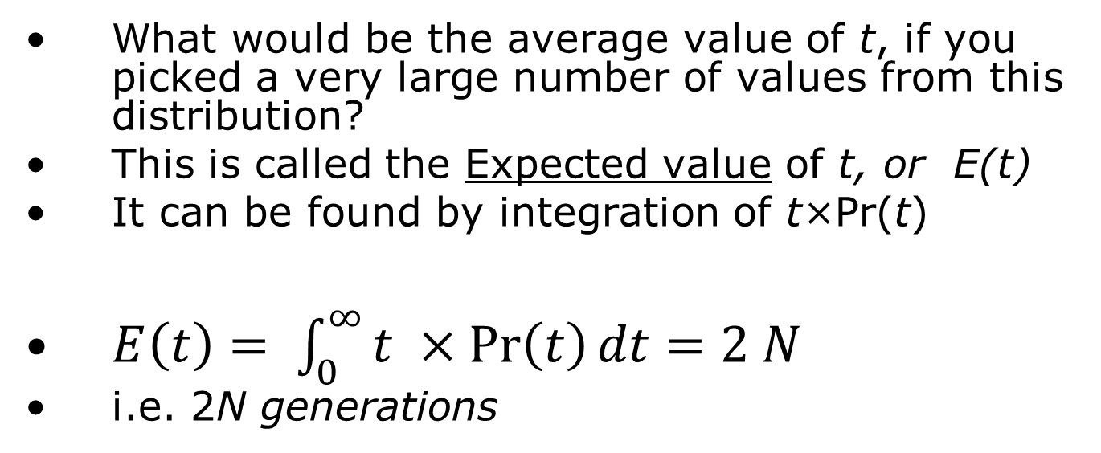
When did two gene copies have a common ancestor?
The probability that the time of common ancestry for two gene copies:
What would be the average value of t, if you picked a very large number of values from this distribution?
This is called the Expected value of t, or E(t)
It can be found by integration of t×Pr(t)
$E\left(t\right)= \int_{0}^{∞}{t ×\operatorname{Pr}\left(t\right)dt}=2 N$
i.e. 2N generations

Slide 18
Time to the next common ancestor for samples of more than 2 gene copies
For a sample of n gene copies, t_{n} is the time from the moment of sampling the n gene copies to the time of the first coalescent.
With 2 gene copies there is only one possible pair that can come together.
With n gene copies there are n(n-1)/2 possible pairs of gene copies that can coalesce

Slide 19
For any part of a tree, when there are j gene copies, what is the time to the next common ancestor?
Let t_{j} be the time in the gene tree during which there are j gene copies
The expected value of tj

Slide 20
The expected time to the most recent common ancestor for a sample of n gene copies
TMRCA – time to the most recent common ancestor of a sample
For a gene tree with n gene copies
Add up the expected time for each of the n-1 time intervals

Slide 21
For n=4
Past
t₂
t₃
t₄
Present time

Slide 22
The expected total time spanned by all the branches, for a sample of n gene copies
T_{tot} – total time spanned by all the branches
For a gene tree with n gene copies
Multiply each expected time by the number of branches during that time

Slide 23
Past
What is the expected total length of the tree, for a sample of n sequences?
t₂
In the case of n=4:
t₃
t₄
Present time

Slide 24
The expected number of mutations
S – the number of neutral mutations on the tree
For a gene tree with n gene copies
A neutral mutation rate, u
What is the expected number of mutations, S?

Slide 25
Past
*
t₂
*
*
What is the expected total number of mutations on a a tree, for a sample of 4 sequences, and a population size of 10,000 and a mutation rate of 0.0001 per generation?
*
t₃
*
*
*
t₄
Present time

Slide 26
Week 4 coalescent simulation assignment
Write a computer program that, for a given value of population size N, sample size n, and mutation rate u:
Simulates a large number of genealogies
Record TMRCA for each genealogy
Record Ttot, the length of each genealogy
Simulate the number of mutations S from a Poisson distribution using a mutation rate of Ttot ×u, and record S.
Print to the screen the expected values and the mean simulated values of TMRCA,Ttot, and S﻿
Use the program to confirm that for N=10000, n=10, u=0.00001, the mean values of TMRCE, T_{tot} and S are close to the expected values as given in the lecture.

